Slide 1
Virtualization Technology
Er. Harneet Kaur
3x-Cloud Certified

Slide 2
Virtualization Technology
Challenges of x86 hardware virtualization
Full virtualization
OS assisted virtualization or Para virtualization
Hardware assisted virtualization
Comparison between Technologies

Slide 3
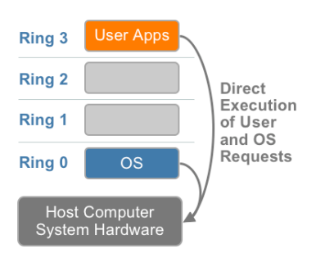
The Challenges of x86 Hardware Virtualization
X86 operating systems are designed to run directly on the bare-metal hardware, so they naturally assume that they fully ‘own’ the computer hardware.
Some sensitive instructions can’t effectively be virtualized as they have different semantics when they are not executed in Ring 0.
The difficulty in trapping and translating these sensitive and privileged instruction requests at runtime was the challenge that originally made x86 architecture virtualization look impossible.
Three alternative techniques now exist for handling sensitive and privileged instructions to virtualize the CPU on the x86 architecture.

Slide 4
a) Full virtualization using binary translation
b)OS assisted virtualization or Para virtualization
c) Hardware assisted virtualization (first generation)

Slide 5
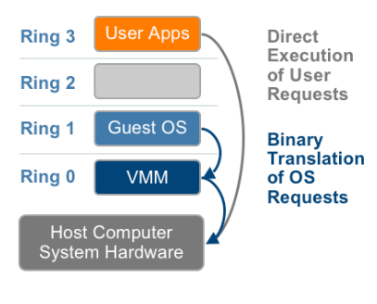
Full Virtualization using Binary Translation
This approach translates kernel code to replace non virtualizable instructions with new sequences of instructions that have the intended effect on the virtual hardware. Meanwhile, user level code is directly executed on the processor for high performance virtualization.
Each virtual machine monitor provides each Virtual Machine with all the services of the physical system, including a virtual BIOS, virtual devices and virtualized memory management.

Slide 6
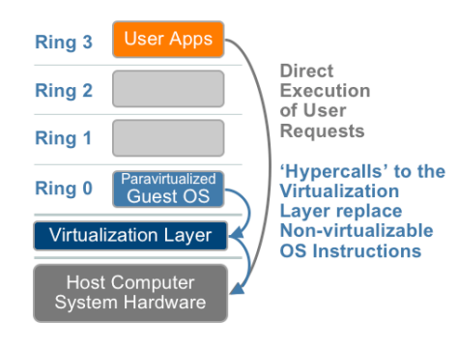
OS Assisted Virtualization or Para Virtualization
Para virtualization refers to communication between the guest OS and the hypervisor to improve performance and efficiency.
Para virtualization involve modifying the OS kernel to replace non virtualizable instructions with hypercalls that communicate directly with the virtualization layer hypervisor.
The hypervisor also provide hypercall interfaces for other critical kernel operations such as memory management, interrupt handling and time keeping.

Slide 7
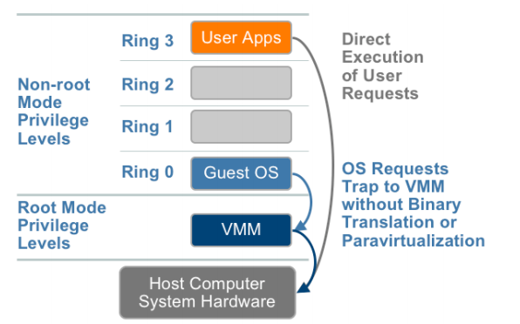
Hardware Assisted Virtualization
In this privileged and sensitive calls are set to automatically trap to the hypervisor, removing the need for either binary translation or para virtualization.
The guest state is stored in Virtual Machine Control Structures (VT-x) or Virtual Machine Control Blocks (AMD-V) Processors with Intel VT and AMD-V

Slide 8
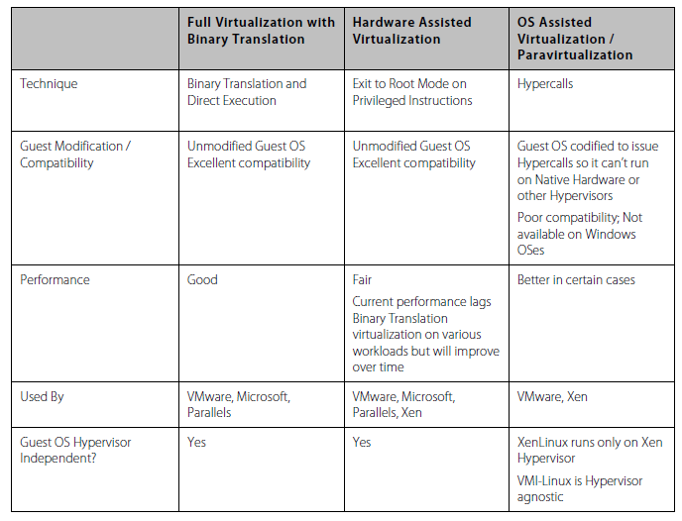

Slide 9
THANK YOU!

